Slide 1
Pre-Calc & Trig
Day 42

Slide 2

Bell Work
Simplify:
$$sin⁡t csc⁡t – cos⁡t sec⁡t$$

Slide 3
Objective
Preview Second Semester of Pre-Calc and Trig
Quick Review of First Semester Pre-Calc and Trig

Slide 4
Second Semester Break Down (3rd Quarter)
Week of Jan 9: Review 1st semester & Start Trig Identities
Week of Jan 15: Trig Identities
Week of Jan 22: Trig Identities
Week of Jan 29: Review Trig Identities
Week of Feb 5: Analytic Trig Test and Law of Sine/Cosine
Week of Feb 12: Law of Sine/Cosine and Vectors
Week of Feb 19: More Trig Identities Test
Week of Feb 26: Systems of Equations
Week of Mar 5: Systems of Equations Test
---End 3rd Quarter---

Slide 5
Second Semester Break Down (4th Quarter)
Week of Mar 12: Spring Break
Week of Mar 19: Start an ACT Unit: Pre; Elem; Interm. Algebra & Geometry
Week of Mar 26: ACT Unit: ACT & Strategies, Practice Exam
Week of Apr 2: Start Matrices Unit (ACT TEST ON 4/3)
Week of Apr 9: Matrices Test
Week of Apr 16: Intro to Calculus with Limits
Week of Apr 23: Calc Limits and Area
Week of Apr 30: Intro to Calc Test and Start Sequences and Series
Week of May 7: Sequence and Series Test (SENIOR FINALS)
Week of May 14: Review for Finals
Week of May 21: Take Finals
---End 4th Quarter---

Slide 6
Trig Identities (Section 4.3 Notes)

Slide 7
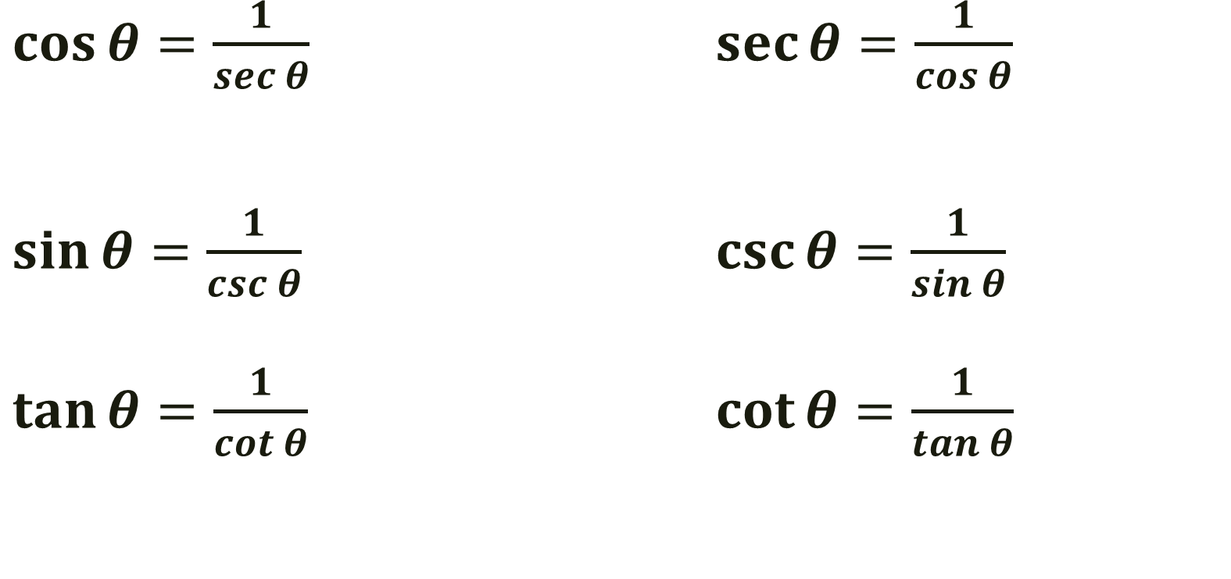
Reciprocal Identities
$\cos{θ=\frac{1}{sec θ}}$ $\sec{θ=\frac{1}{cos θ}}$
$\sin{θ=\frac{1}{csc θ}}$ $\csc{θ=\frac{1}{sin θ}}$
$\tan{θ=\frac{1}{cot θ}}$ $\cot{θ=\frac{1}{tan θ}}$

Slide 8

Quotient Identities
$\tan{θ=\frac{sin θ}{cos θ}}$ $\cot{θ=\frac{cos θ}{sin θ}}$

Slide 9
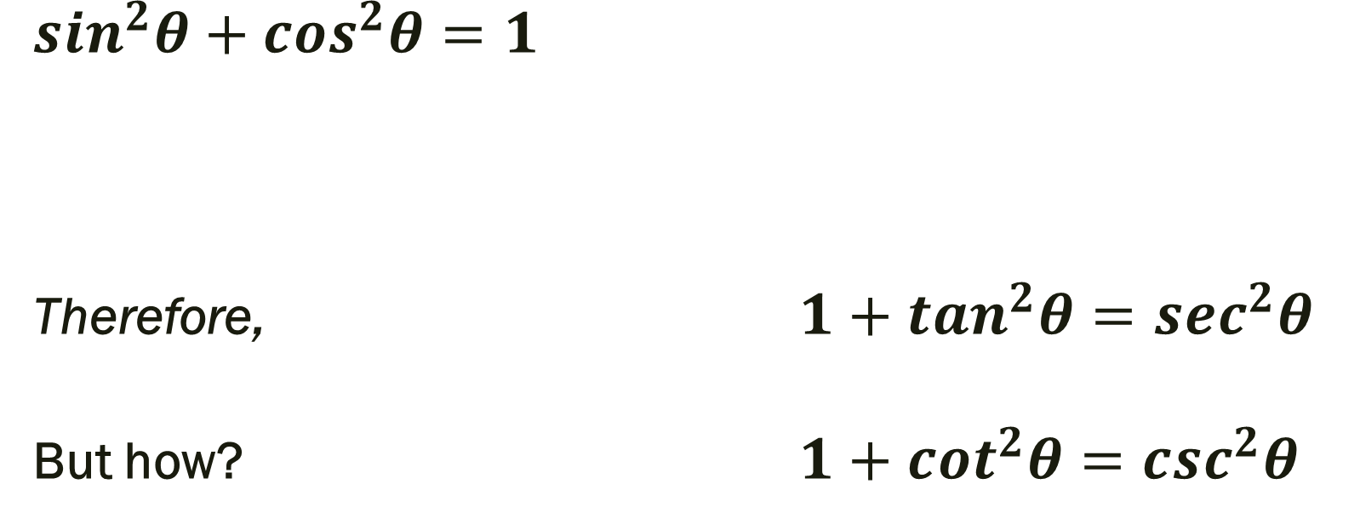
Pythagorean Identities
$\sin^{2}θ+cos^{2}θ=1$
Therefore, $1+tan^{2}θ=\sec^{2}θ$
But how? $1+cot^{2}θ=c{sc}^{2}θ$

Slide 10

Simplify
$$1.) csc⁡x sec⁡x – tan⁡x$$
$$2.) \frac{1−\sin^{2}x}{\csc^{2}x−1}$$

Slide 11
For Next Time
Page 307 #37 – 46

